Slide 1

NRCan OpenDRR Platform
Technology Brief

Slide 2
Stated objective
“The OpenDRR platform aims to provide tools to investigate, assess, and mitigate natural disasters for policy makers, risk analysts, private and public institutions, and citizens to facilitate decision-making prior to a crisis.”
Requirements compiled by Minerva: https://opendrr.github.io/documentation/docs/opendrr-platform.html

Slide 3


Motivation – Policy on Service and Digital
Principles:
design with users
iterate and improve frequently
work in the open by default
use open standards and solutions
collaborate widely
There are protocols and workflows to facilitate this!

Slide 4

Motivation – Open Science Initiative
To make Canadian science open to all, maximizing benefits for the well-being, health and economy of our country.
Deadline is 2022-2023 for all GC scientific articles and publications to be “open” by default.
Notes:
The FAIR Data Principles are a set of guiding principles in order to make data findable, accessible, interoperable and reusable (Wilkinson et al., 2016).
These principles provide guidance for scientific data management and stewardship and are relevant to all stakeholders in the current digital ecosystem.
They directly address data producers and data publishers to promote maximum use of research data.
Research libraries can use the FAIR Data Principles as a framework for fostering and extending research data services.

Slide 5
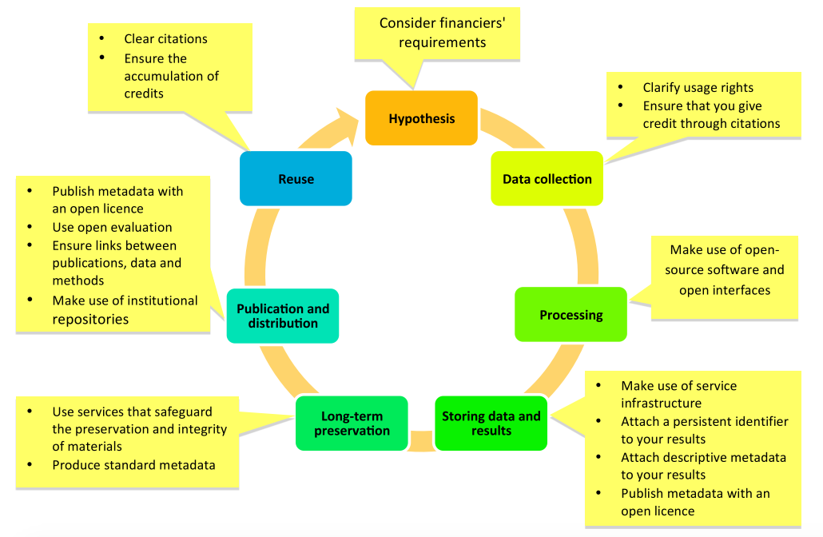
Promoting openness at different stages of the research process (from https://www. fosteropenscience.eu)
Notes:
Stages of the research process

Slide 6



Primary Users*
Risk Analyst
Generate scenario outputs
Allow for peer-review of outputs
Disseminate outputs
Emergency Manager, Land-Use Planner, Risk Manager
Access to up-to-date hazard scenarios
Access to scenario outputs and datasets
Ability to integrate scenario data into a GIS
Individual/business
Intuitive and context aware access to hazard scenarios
High level overview of risk
Natural language descriptions and simple but effective visualizations
* Taken from requirements compiled by Minerva: https://opendrr.github.io/documentation/docs/opendrr-platform.html

Slide 7

Workflow
Refine
Engagement & Collaboration
Model Scenarios
Generate Scenario Outputs
Peer Review
Publish
Share
Notes:
Public friendly science!

Slide 8







Key Components
RiskProfiler
Dashboard
API’s
OpenQuake Engine
GitHub Repository
Public Portal (RiskProfiler.ca)
Dashboard
API’s
GitHub
OpenQuake Engine

Slide 9


Open Quake Engine
GEM’s state-of-the-art, open-source software collaboratively developed for earthquake hazard and risk modelling
Generates raw scenario outputs for further processing
Risk Analysts push outputs to the GitHub data repository
OpenQuake Engine
Scenario Outputs
GitHub
Notes:
The OpenQuake Engine is an open source application that allows users to compute seismic hazard and seismic risk of earthquakes on a global scale.

Slide 10
GitHub Repository
OpenQuake Engine
Foster Collaboration and Engagement
Facilitate peer-review and editing (Private Repo)
Facilitate broader dissemination (Public Repo)
Facilitate public engagement
Benefits
Open science
Provide a feedback loop
Promote transparency
Scenario Outputs
GitHub

Slide 11
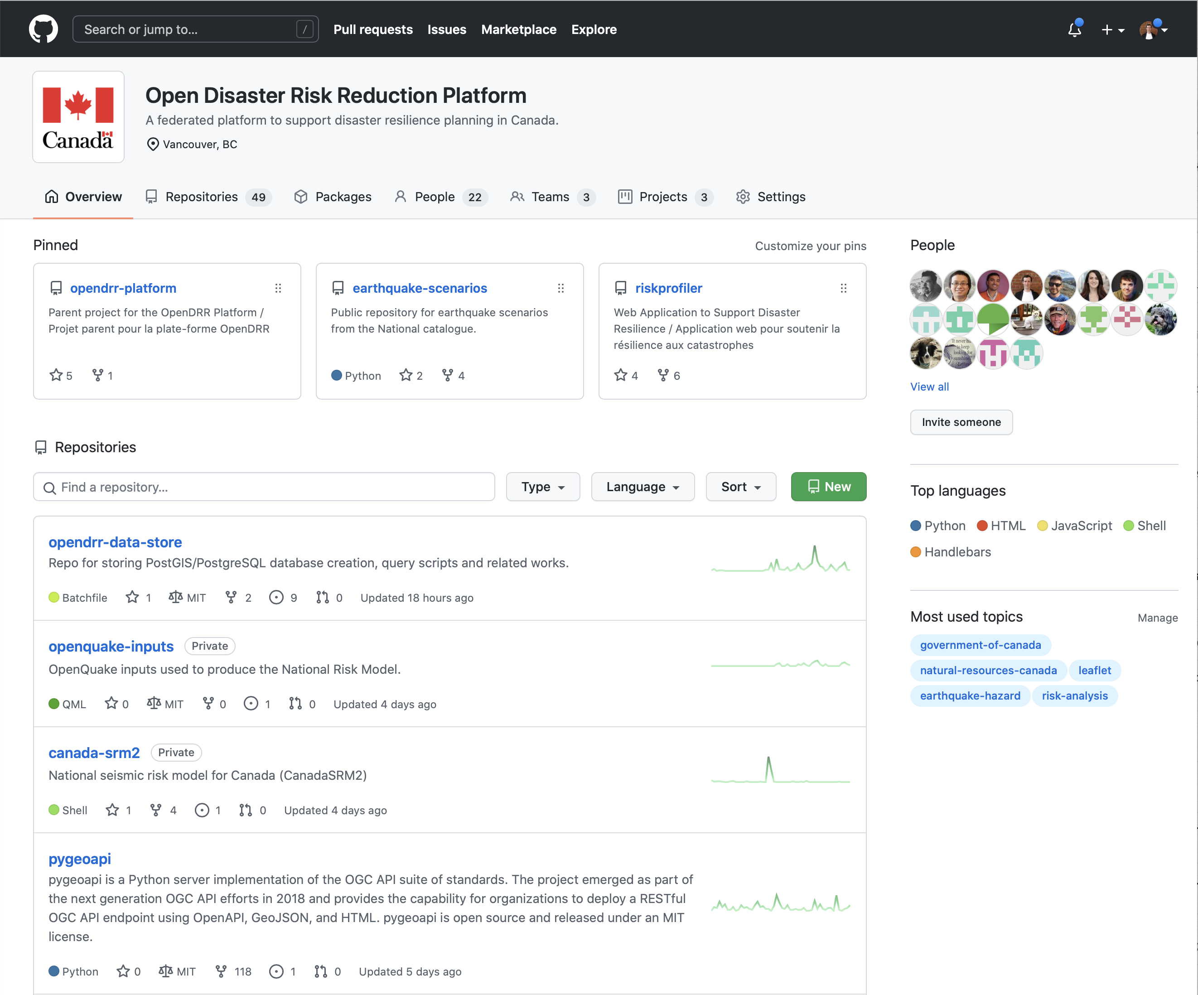
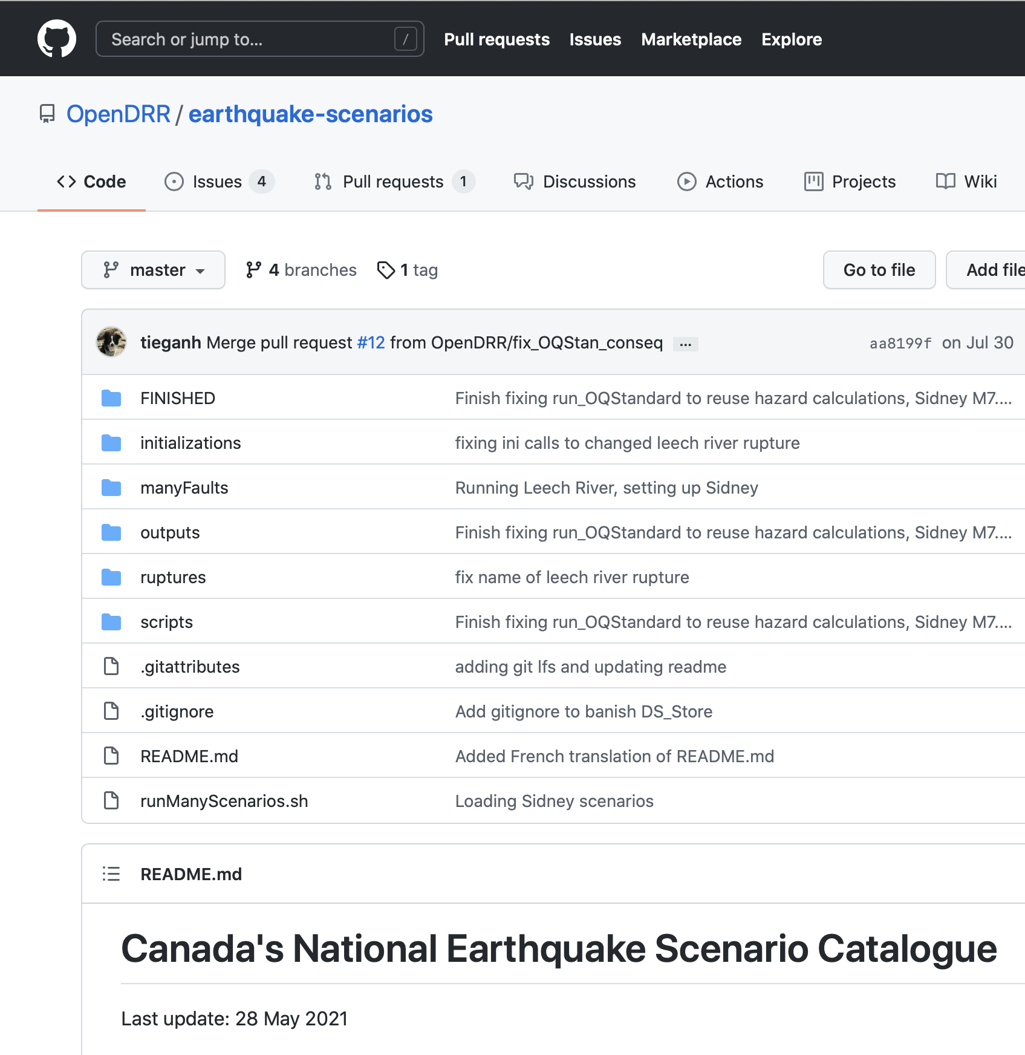
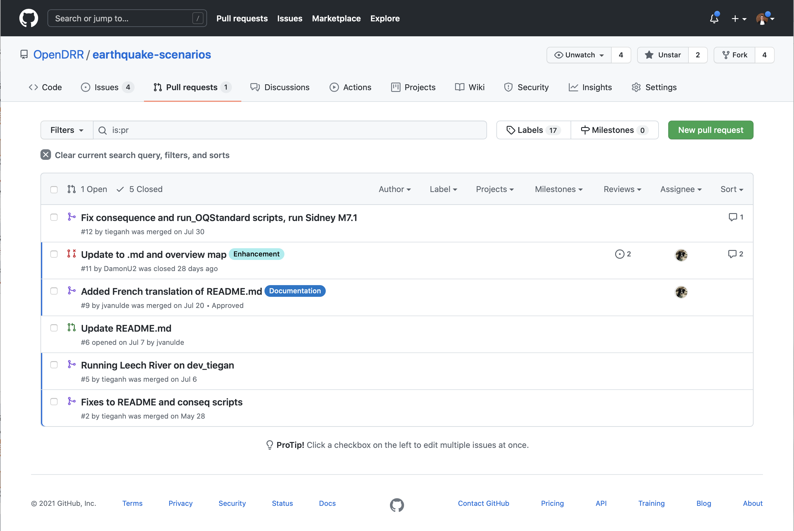
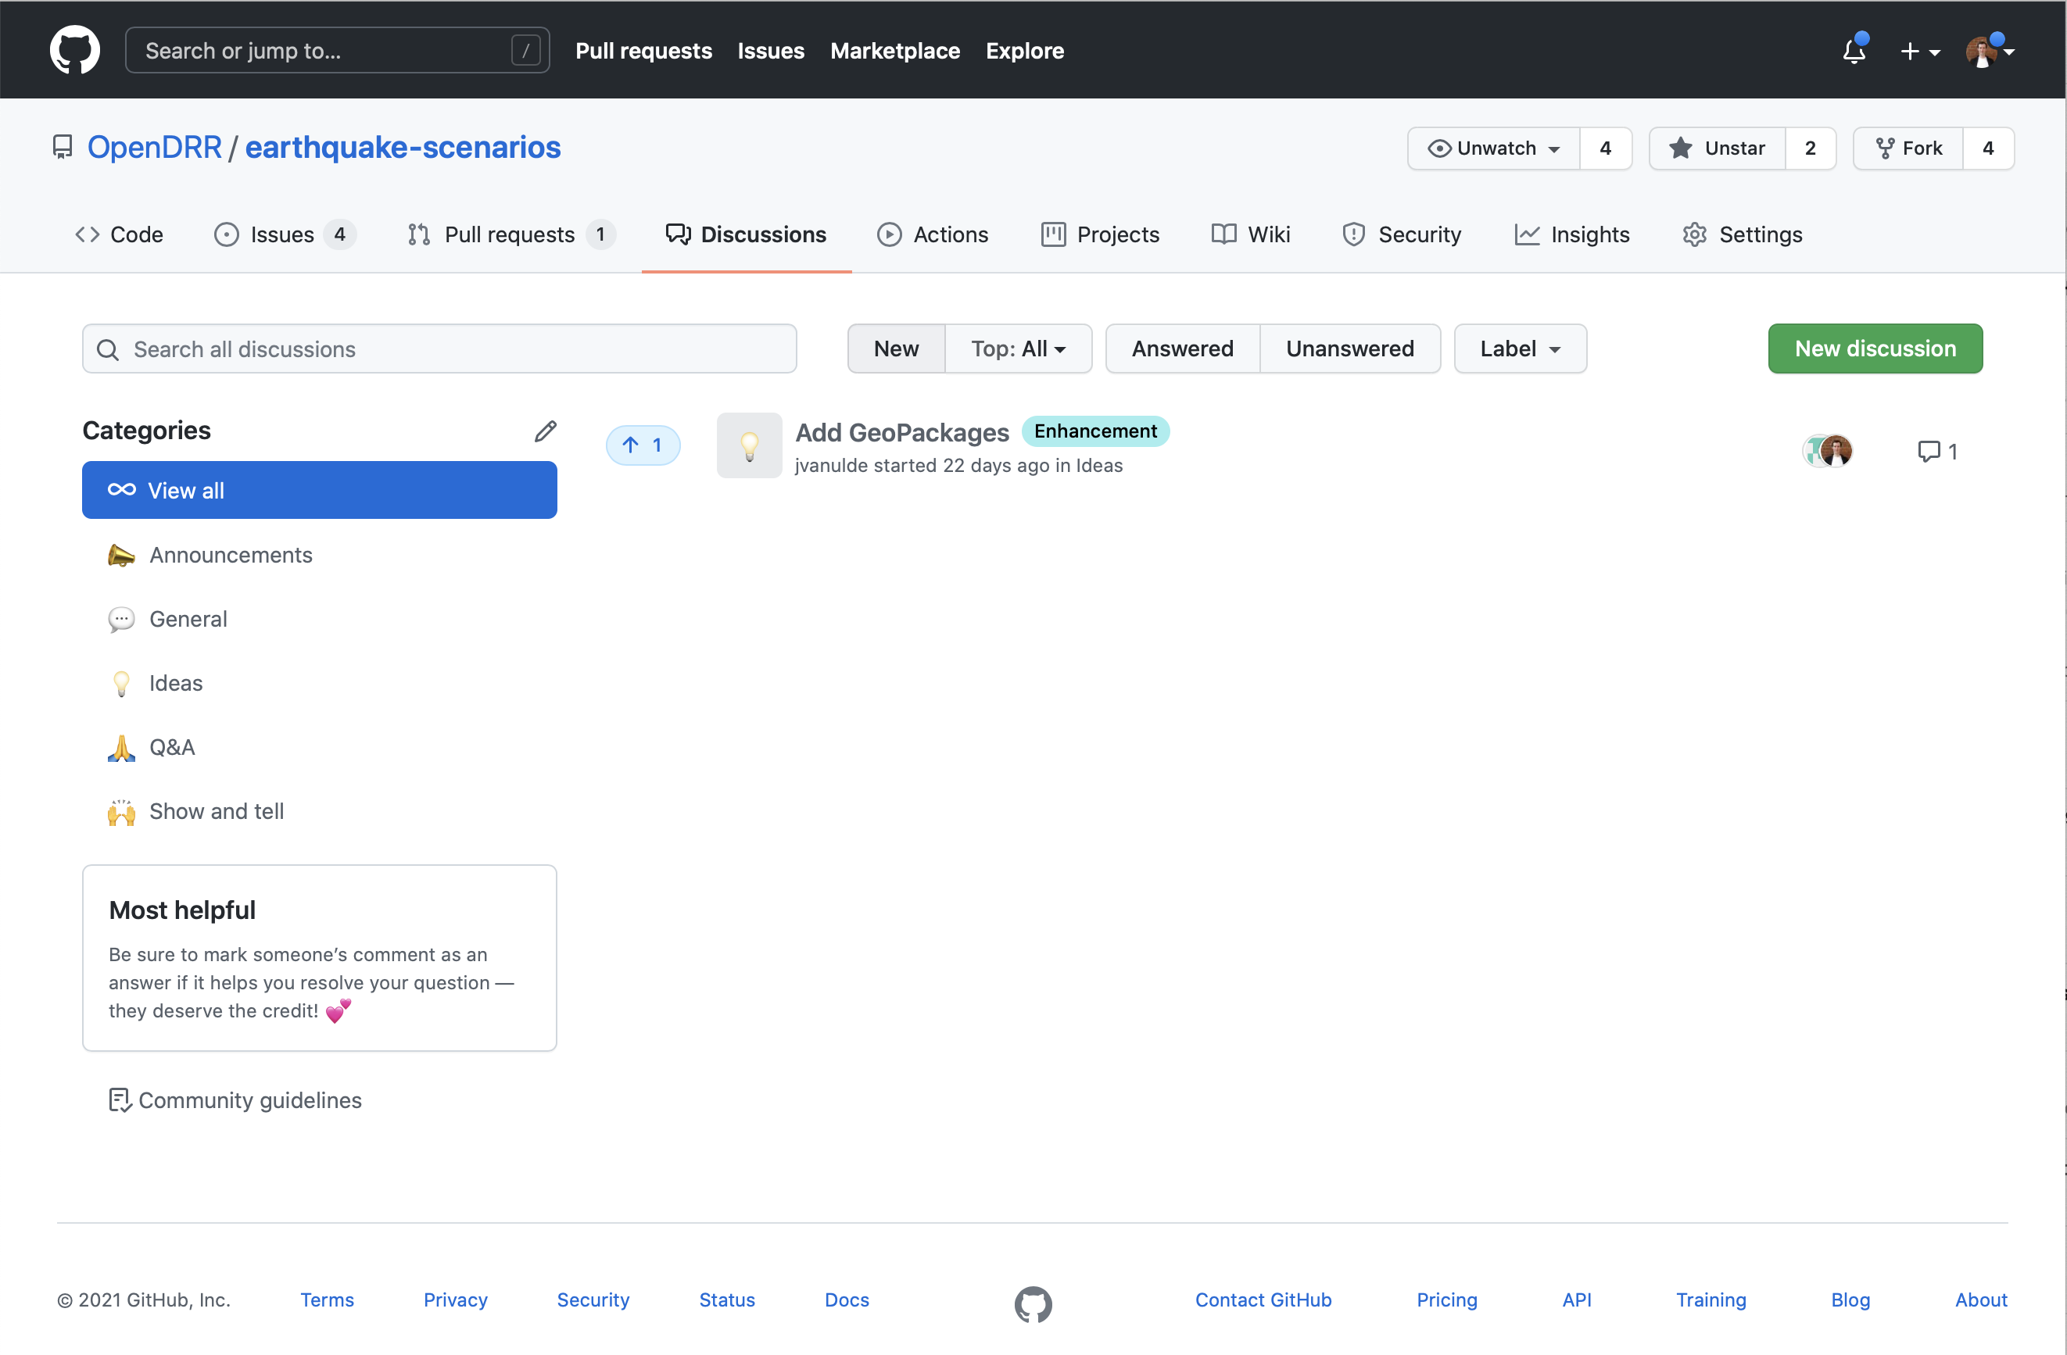
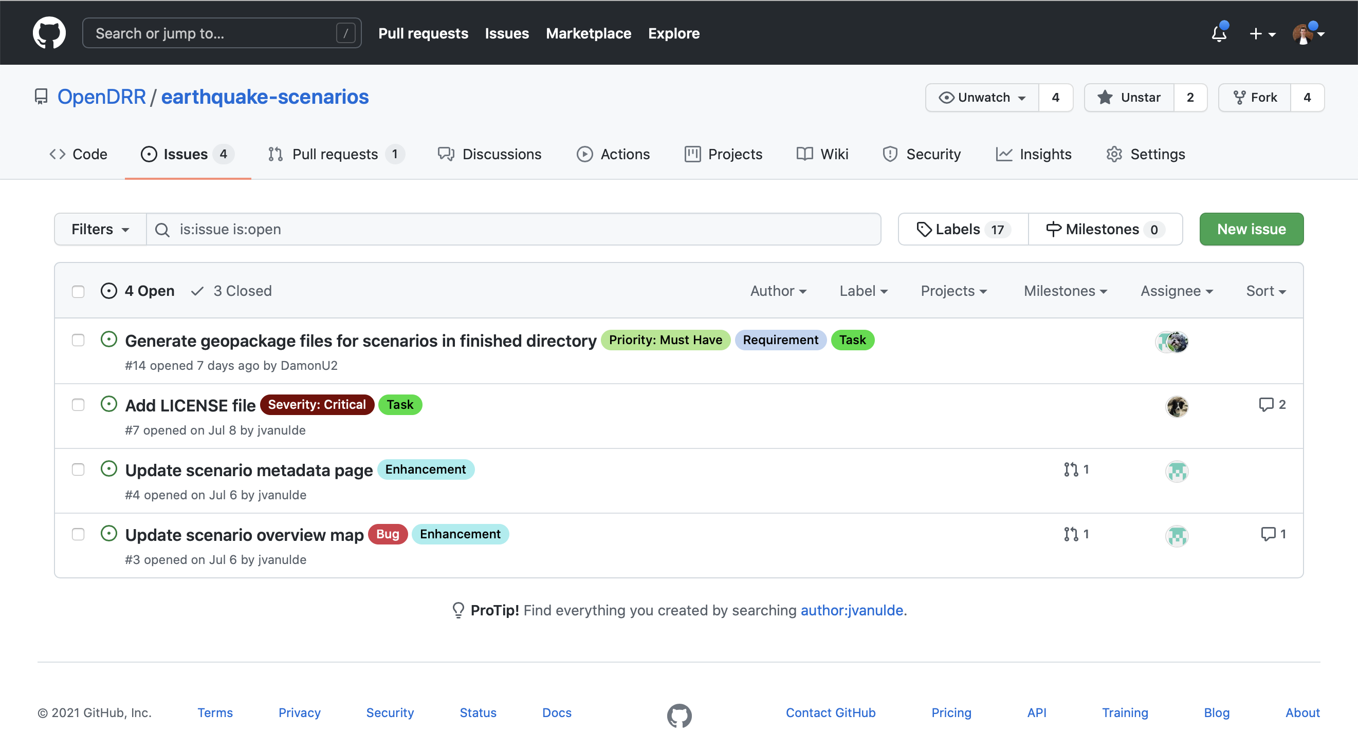
GitHub
Products
Collaboration
Pull Requests
Contributions
Patches
Repositories
Data products
Software code
Engagement
Feedback
Issues
Bugs
Tasks
Milestones
Discussion Boards
Suggestions
Announcements
Q&A

Slide 12


GitHub Repository
OpenQuake Engine
Deployable solutions
Infrastructure as code (i.e. Containers)
Software code
Robust documentation
Code samples
R5 Principles
R1. Re-runnable
R2. Repeatable
R3. Reproducible
R4. Reusable
R5. Replicable
Risk Indicators
Scenario Outputs
Model Factory
Spatial Database
GitHub

Slide 13
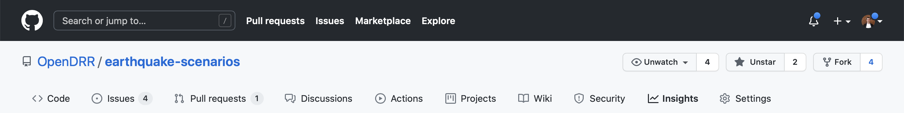
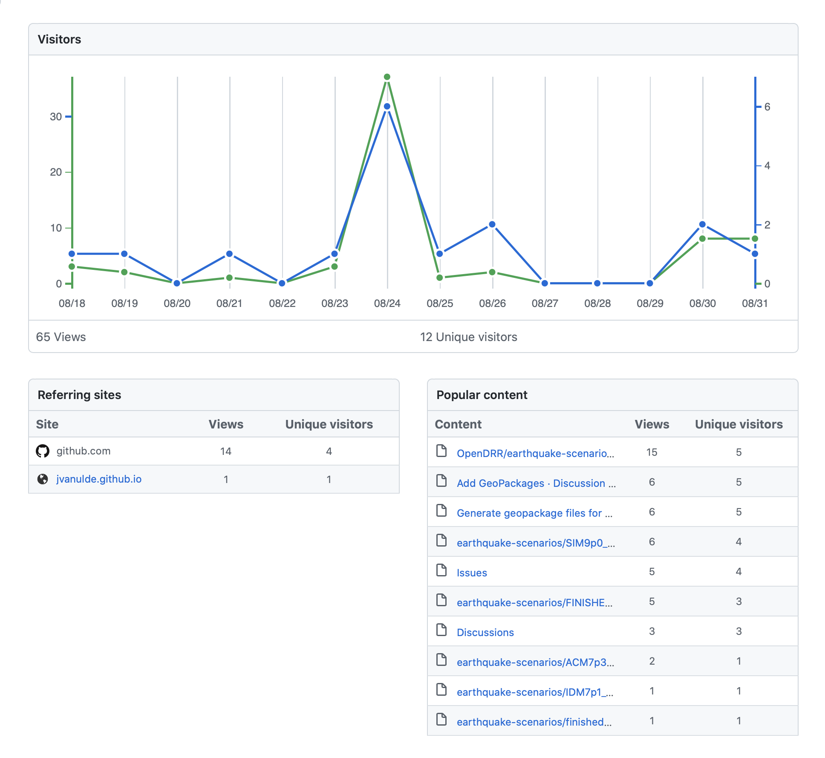
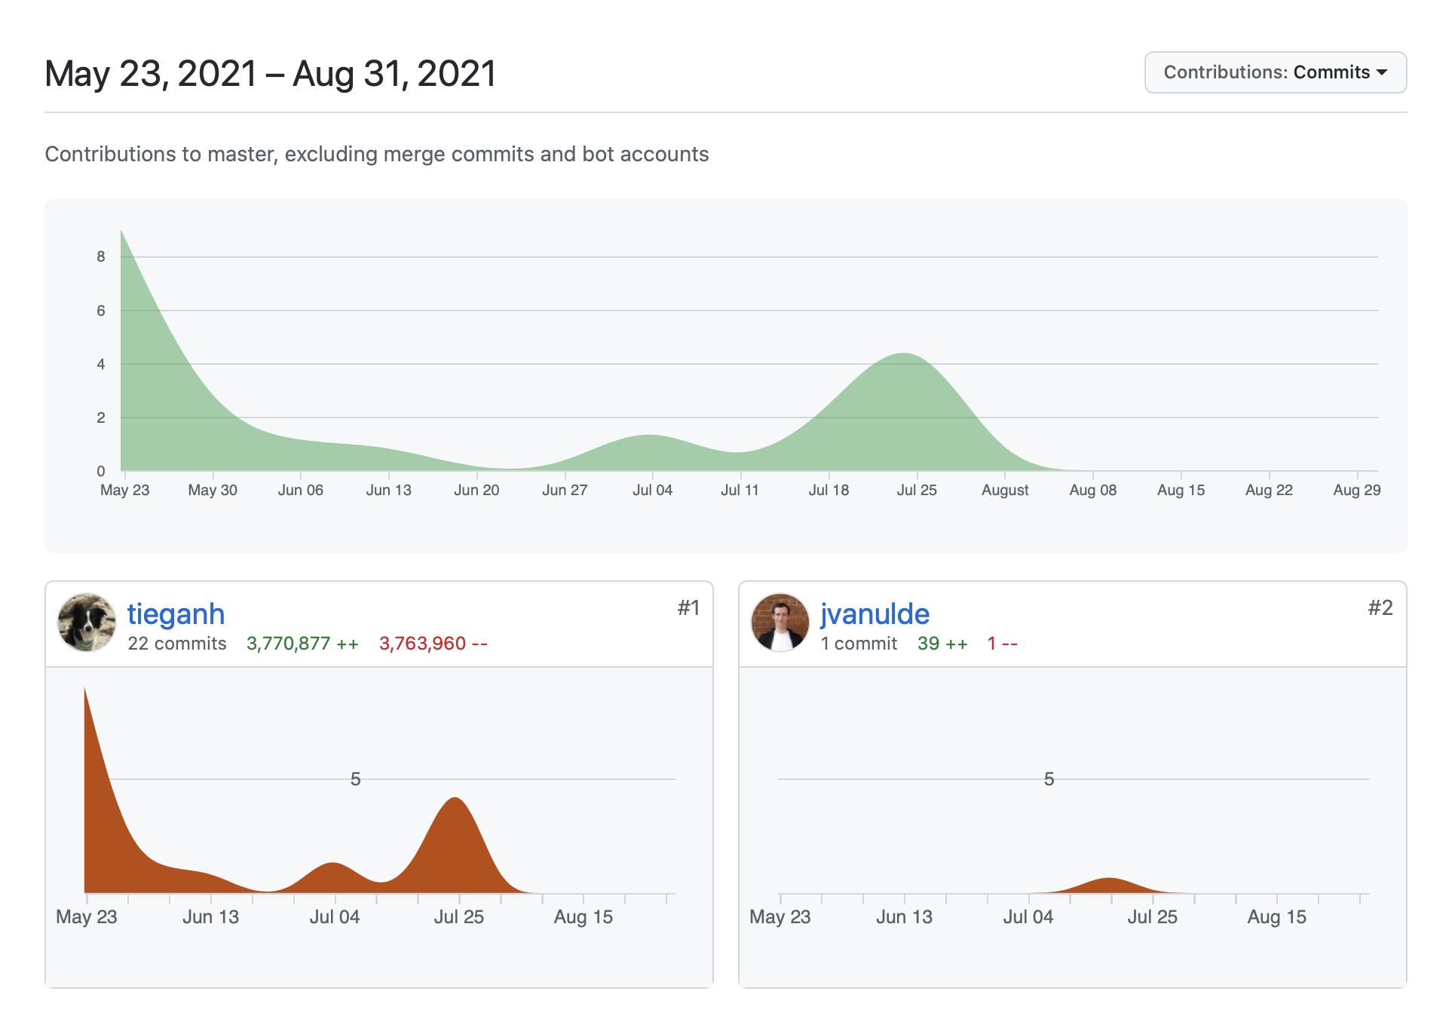
Key Performance Indicators
Visitors
User traffic
Referring sites
Popular content
Contributors
Who is contributing
Type of contributions
Level of contribution
Stars
Measures interest
Represents “bookmarks”
Used to rank repositories
Forks
Measures reuse
Who is reusing the code/data
How is the code/data being reused

Slide 14
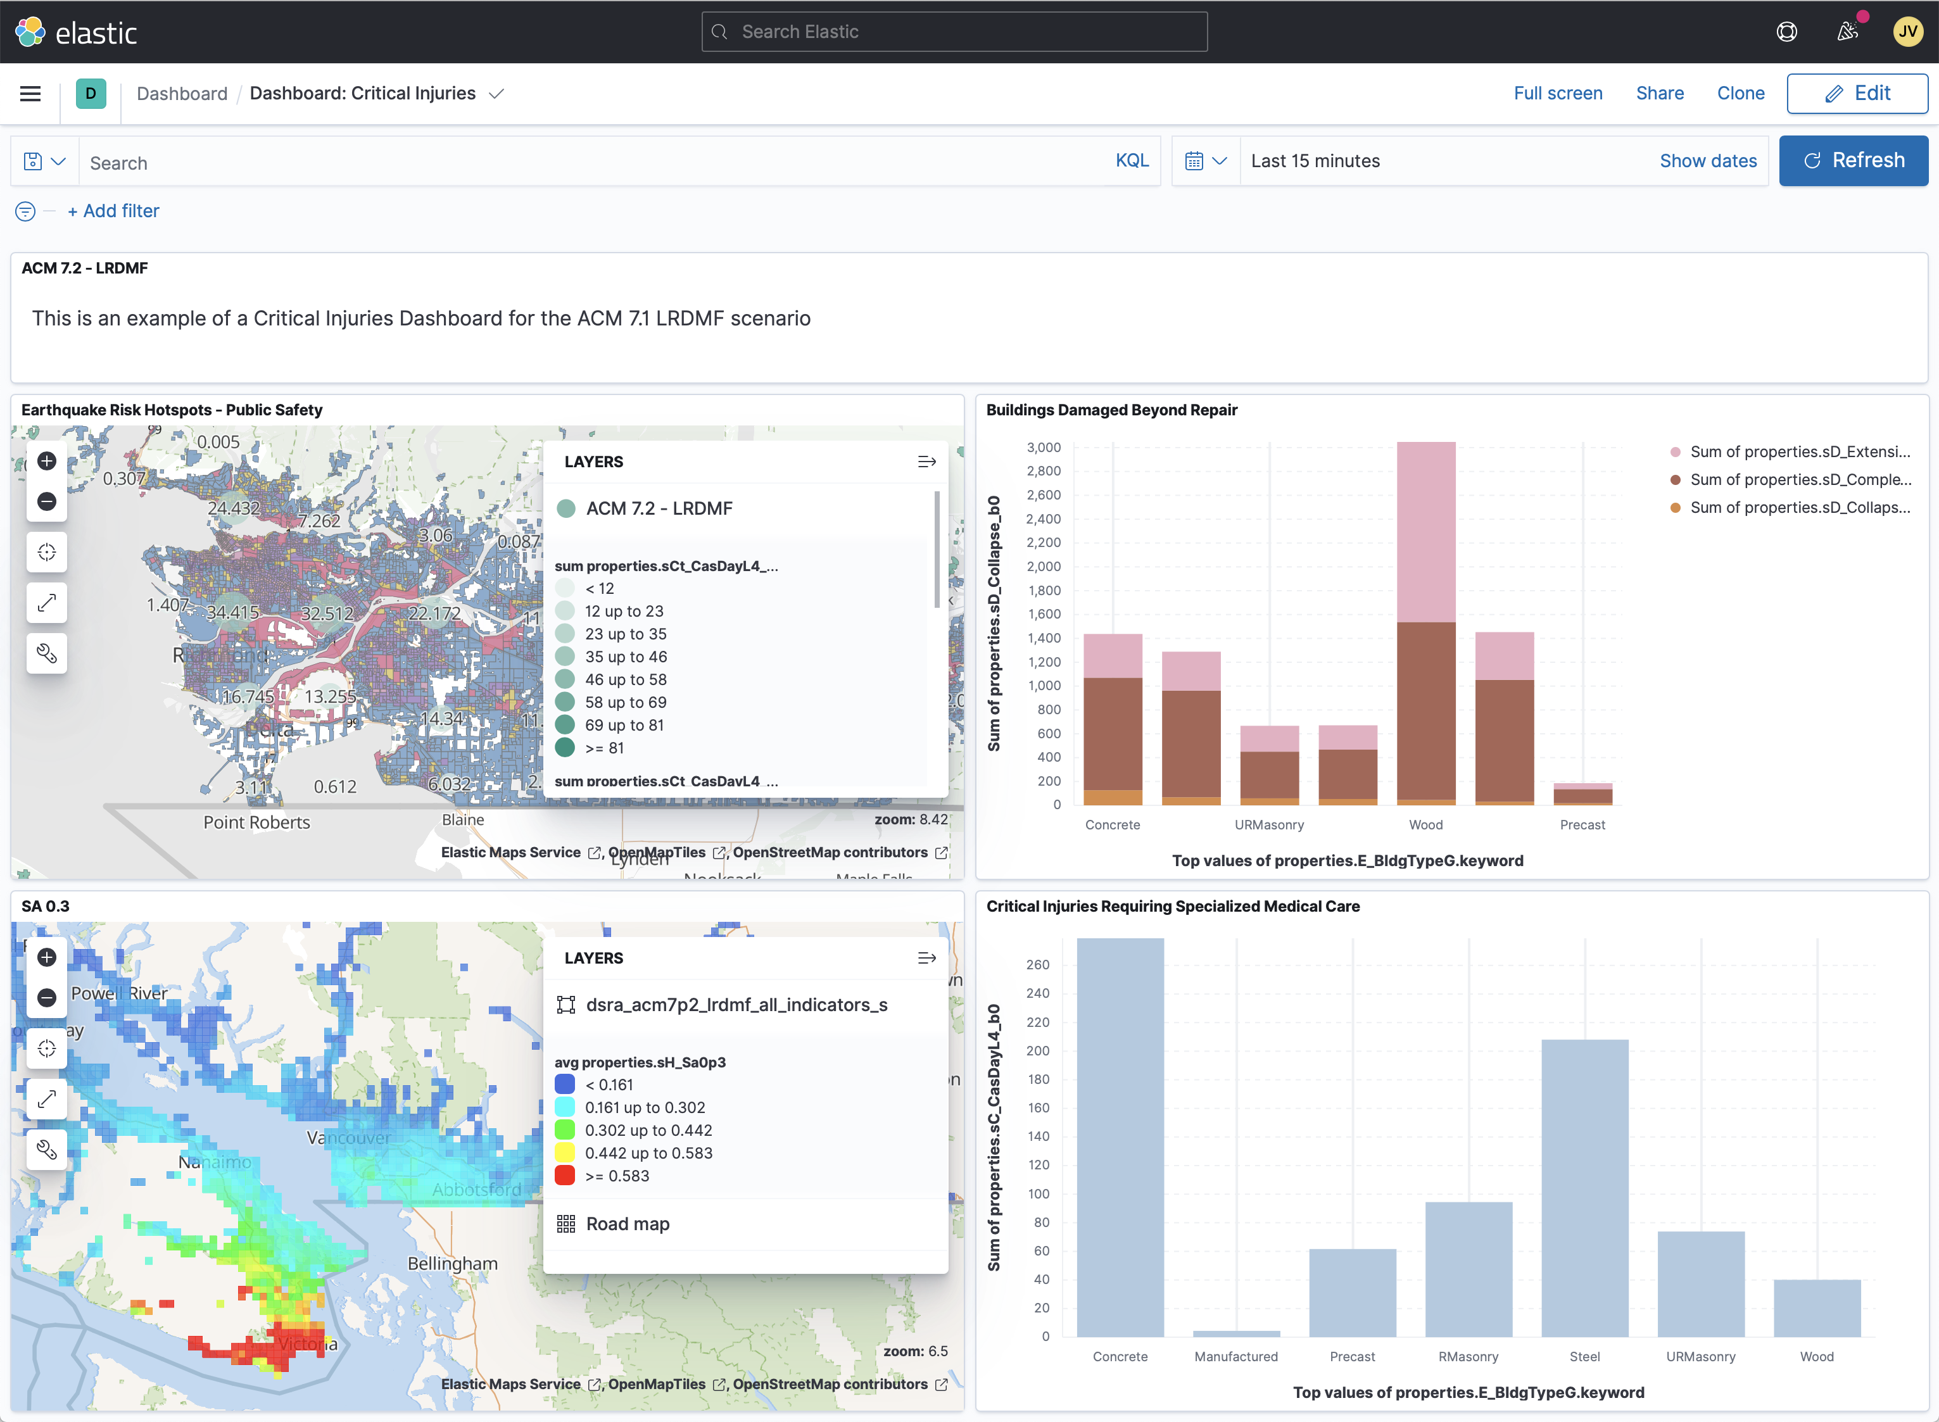

Public Dashboard (Experimental)
Kibana
Pre-generated dashboards with visualizations
Allows users to query underlying models and visualize results using charts, graphs, and maps
Users can share results outside of the platform
Elasticsearch
OpenDRR GitHub
Launching in 2021
Spatial Database
https://dashboard.stage.riskprofiler.ca

Slide 15
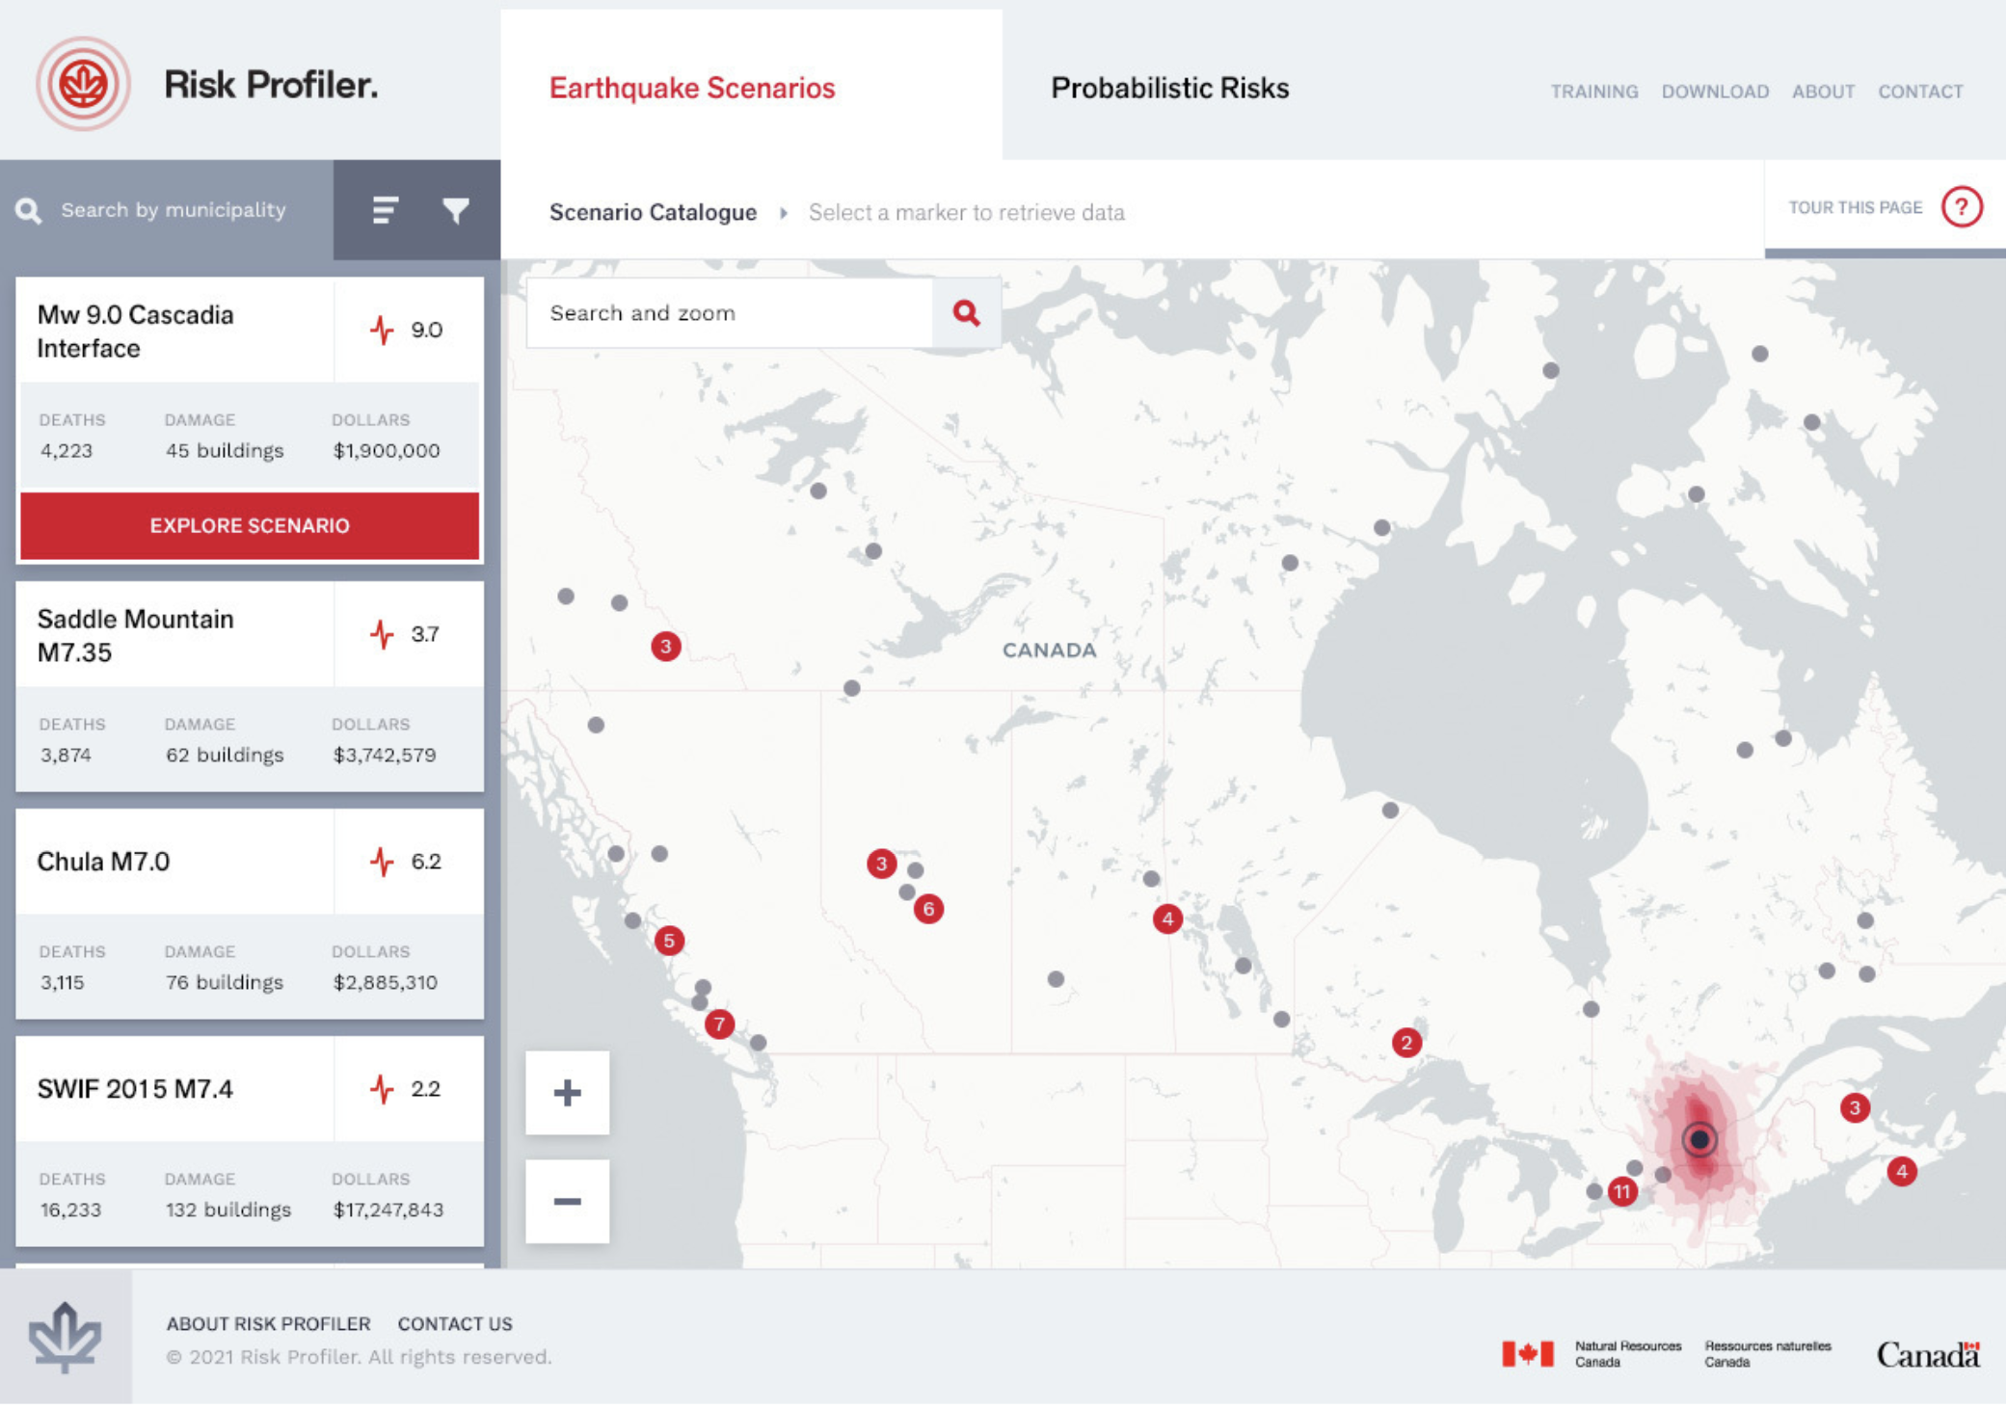
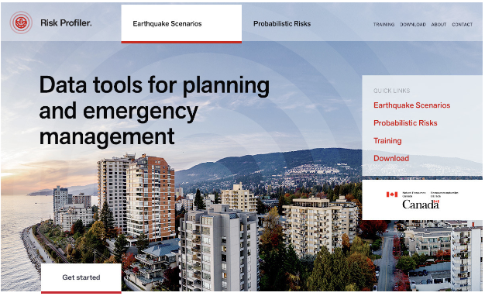
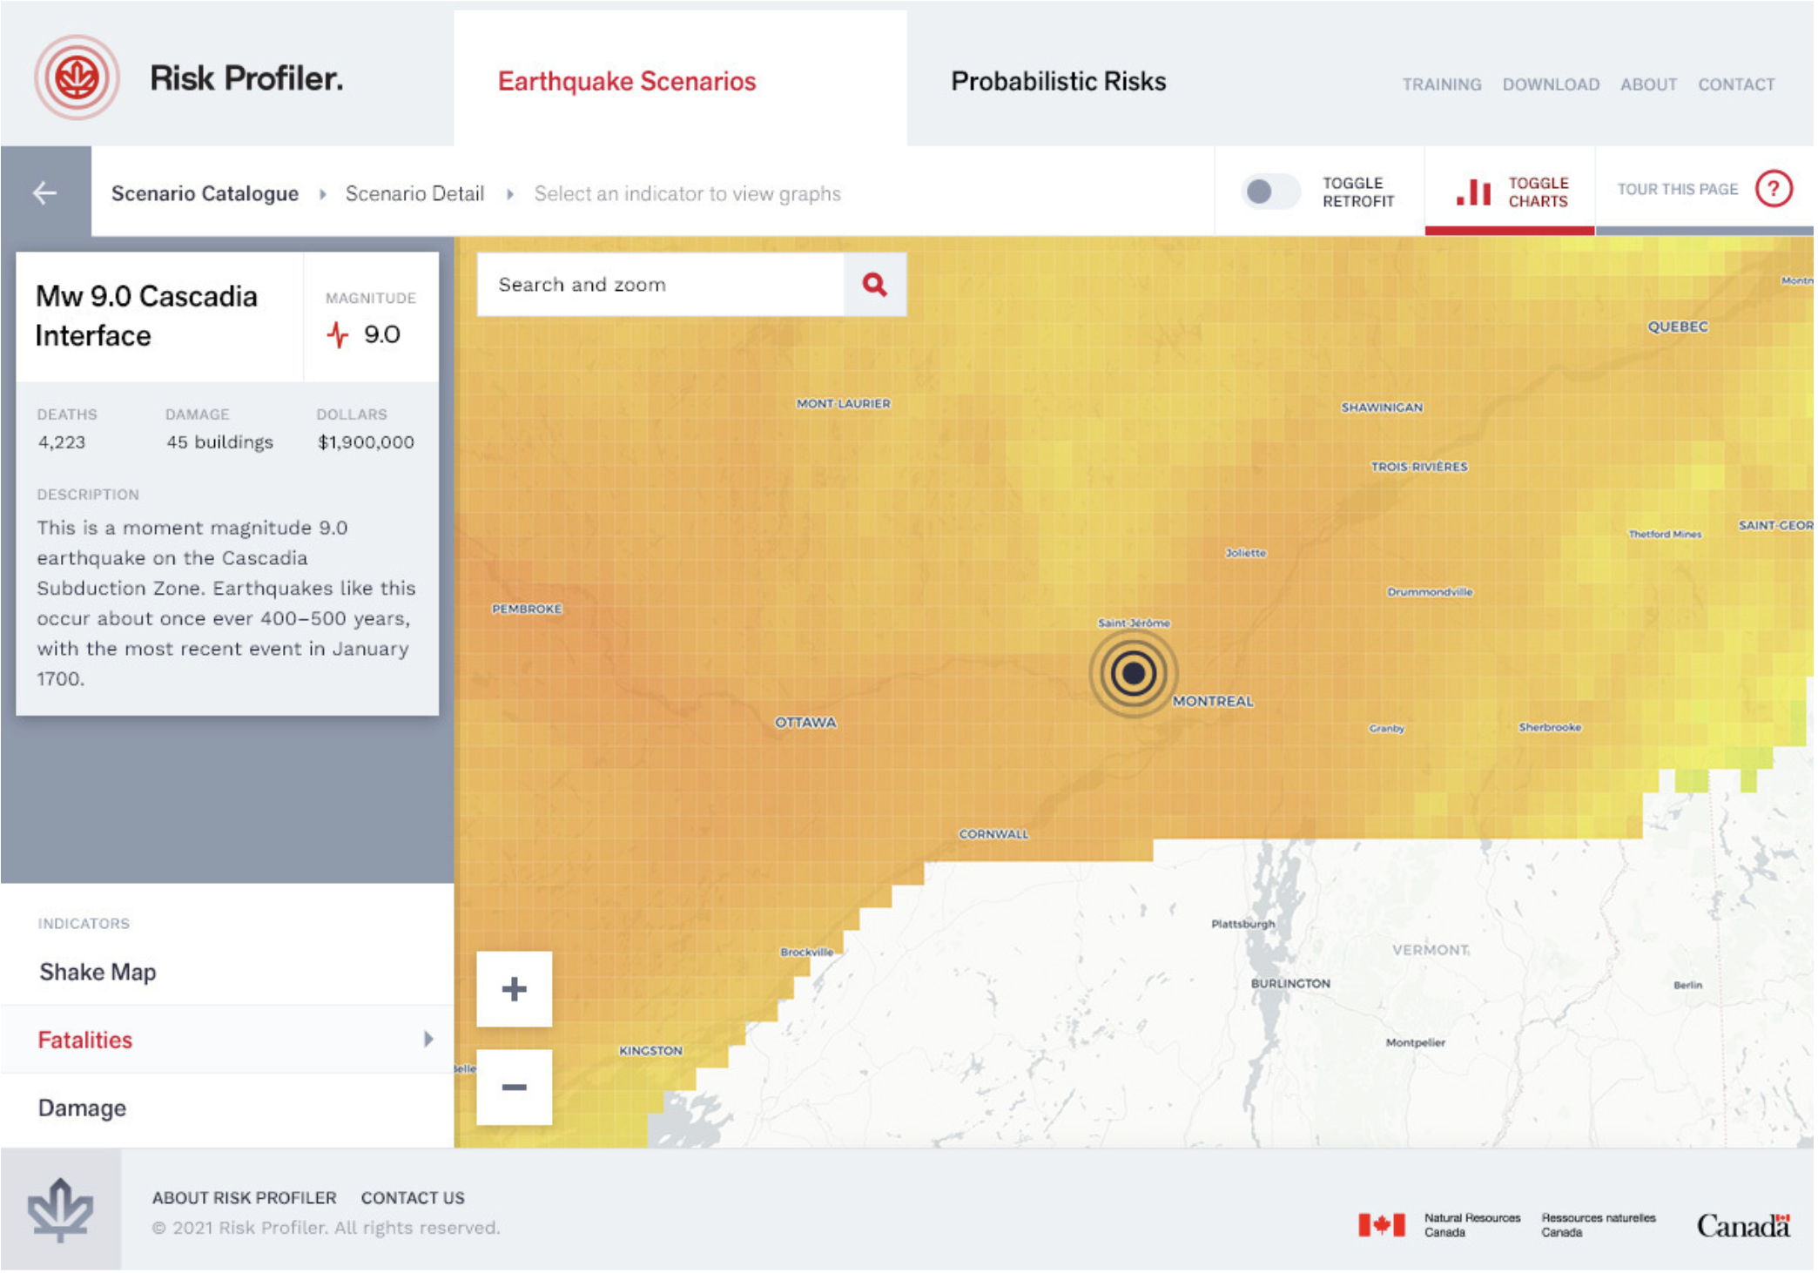
RiskProfiler.ca
Currently in design phase!
Purpose-built web application for Emergency planners/managers
High-level overview of hazard risk
Interactive maps and graphic visualizations
OGC API
Elasticsearch
OpenDRR GitHub
Launching in 2021
Spatial Database

Slide 16





API’s
Web Services
Developers
Mobile
Web Apps
OGC API’s
Features (w/ CQL-JSON)
Records (prototyping)
developer portal
Elasticsearch API
non-spatial
dashboard data source
ESRI REST
Traditional GIS
Hosted by FGP
OGC API
ES API
ESRI REST
Elasticsearch
ArcGIS Server
OpenDRR GitHub
OpenDRR Spatial Database
Federal Geospatial Platform

Slide 17











Dashboard
RiskProfiler
CGP
Open Data
F/P/T Portals
Emergency Theme
OGC API
Metadata
Services
Elasticsearch
Risk Analyst
Federal Geospatial Platform
Emergency Planner
Web Services
Spatial Database
GC User
Public
Risk Indicators
Enterprise Cloud Services
Standards
Best of breed
Scalable
Download
Models
Datasets
Documentation
OpenQuake Engine
OpenDRR GitHub

Slide 18
For more information
Reach me at: joost.vanulden@canada.ca
Find us at:
https://github.com/OpenDRR

